Slide 1
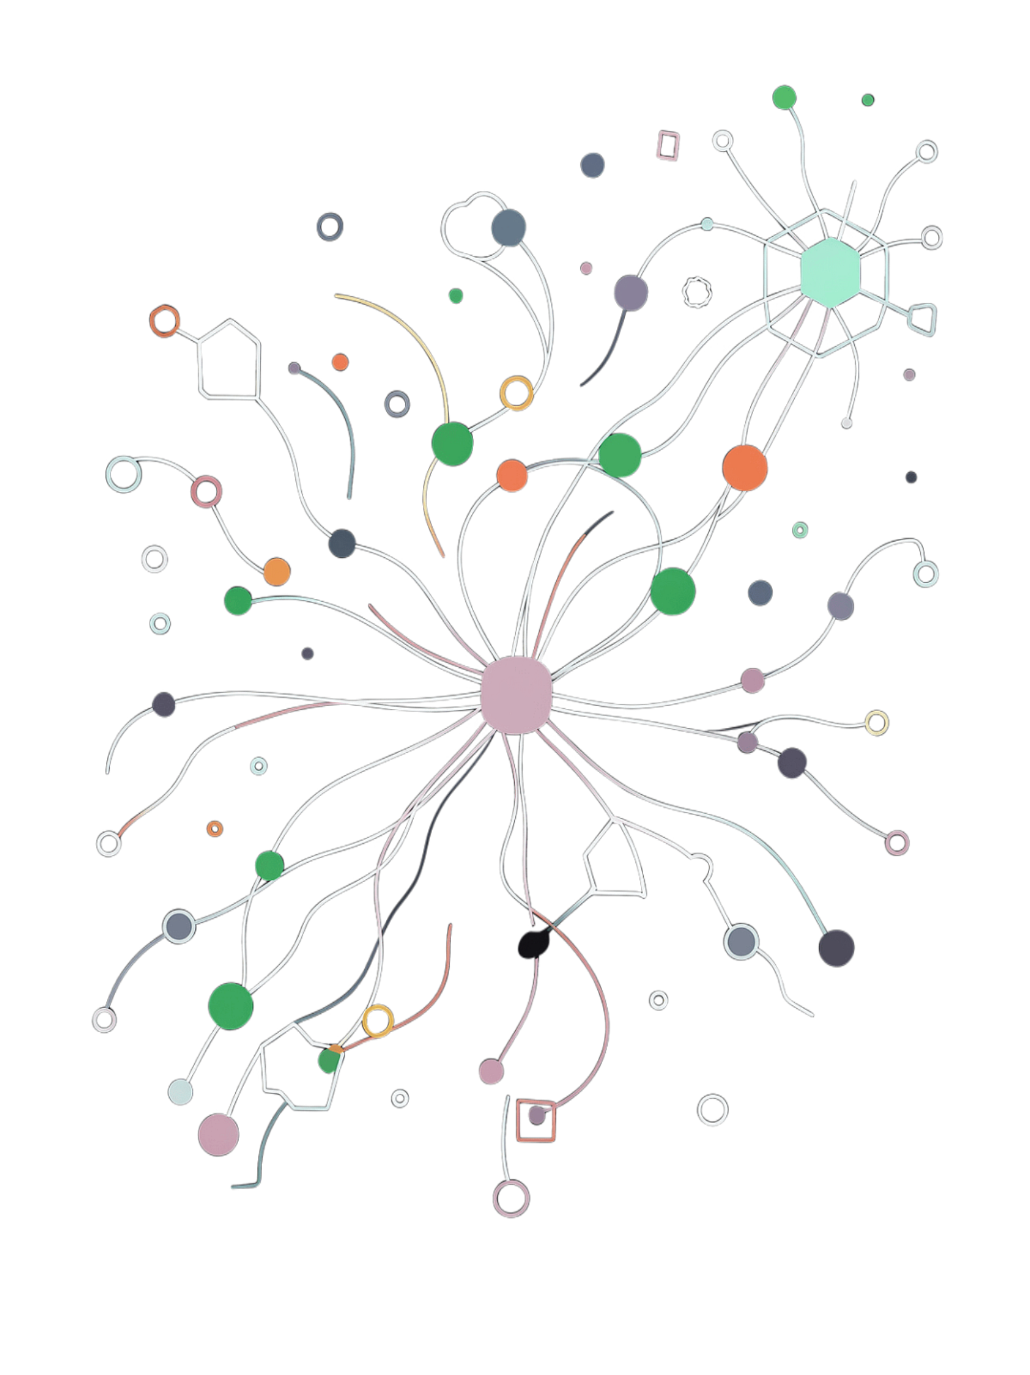
QueryMind
Ask Better Questions. Discover Better Insights.
AI-Powered Conversational Data Analytics — Turn natural-language questions into SQL, results, and visual insights.

Slide 2

Data Is Everywhere. Understanding It Isn't.
Organizations have massive amounts of data
Accessing useful insights often requires technical knowledge
SQL creates a barrier for non-technical users
Traditional workflows require switching between datasets, query tools, and visualization platforms
Simple business questions can require significant technical effort
The Traditional Path
Raw Data → SQL / Technical Complexity → Multiple Tools → Delayed Insights
People shouldn't need to be SQL experts to ask questions about their data.

Slide 3





What If You Could Just Ask Your Data?
Traditional Analytics Workflow
QueryMind Workflow
Question
Question
Find Data
AI
Write SQL
Insight
Debug & Run
Natural language becomes the interface between people and data.
Build Chart

Slide 4

Meet QueryMind
QueryMind transforms natural-language questions into executable analytics in a single unified workflow.
Upload
Ask
Understand
Generate SQL
Analyze
Visualize
Example: "Show me the top 10 products by sales." → Natural Language → Generated SQL → Results Table → Bar Chart. One question. One workflow. Multiple insights.

Slide 5





From Question to Insight
01 — Upload
02 — Ask
03 — Generate
Upload a dataset into QueryMind.
Ask a question naturally.
AI converts the question into SQL.
04 — Analyze
05 — Visualize
Execute the query and return structured results.
Turn results into charts for faster understanding.

Slide 6

One Workspace. Everything You Need.
📁 Dataset Upload
📊 Results
Bring your data into the workspace.
Explore structured analytical results.
💬 Natural Language Query
📈 Interactive Charts
Ask questions without writing SQL.
Understand patterns visually.
🧠 Generated SQL
🕘 Query History
See the exact query produced by the AI.
Revisit previous analysis anytime.
QueryMind doesn't just give an answer — it shows how the answer was queried.

Slide 7
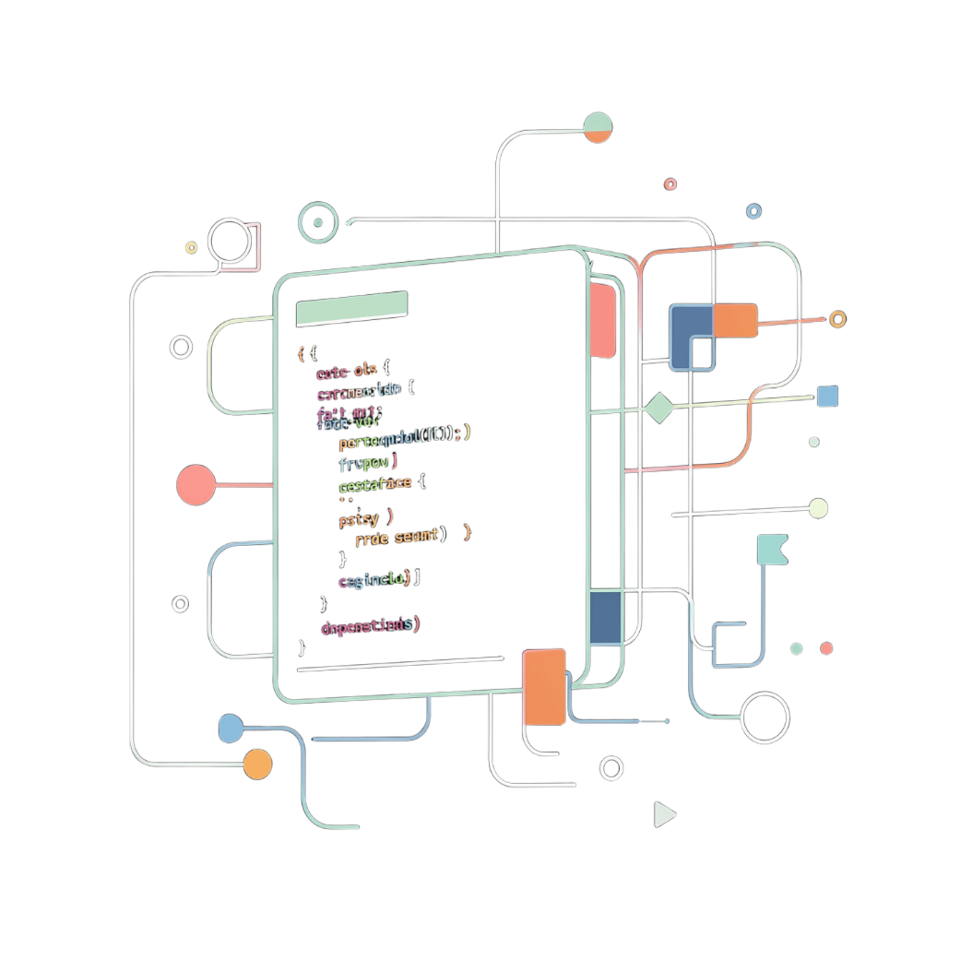
Why QueryMind?
1
Conversational Analytics
Ask questions the way you think — no syntax required.
2
Transparent AI
Generated SQL keeps the analytical process fully visible and auditable.
3
Insight + Visualization
Move directly from query results to understandable charts.
4
Accessible Data Exploration
Reduce the technical barrier between people and their data. 🌍 Designed to evolve toward multilingual analytics.

Slide 8

AI + Data + Analytics, Connected
User
Stack Highlights
QueryMind Frontend
QueryMind combines a conversational AI interface with a powerful analytical data layer — a bridge between human questions and data-driven answers.
FastAPI Backend
AI / LLM
Frontend
Backend
AI / LLM
Data Layer
React · TypeScript · Tailwind
FastAPI
Natural Language Understanding
Exasol Analytical Platform

Slide 9
Where QueryMind Goes Next
NOW
NEXT
FUTURE
Natural-language analytics
SQL generation
Interactive visualizations
Query history
Modern analytics workspace
Full multilingual query support
Broader file-format support
Automated dashboard generation
AI-generated analytical reports
Exportable insights
Conversational data exploration
Intelligent chart recommendations
Personalized analytics workspaces
Deeper Exasol-powered workflows
Advanced AI-assisted analytics

Slide 10

Make Data Something You Can Talk To.
QueryMind turns data from something you query into something you can talk to.
Ask a Question
Understand the Answer
Discover the Insight
QUERYMIND — Ask Better Questions. Discover Better Insights.

